Slide 1
Electric Vehicle Charging Station Network Optimization
Course Project
ME308 : Industrial Engineering and Operations Research (Spring 2021-22)
Department of Mechanical Engineering, IIT Bombay
Group 23
Abhijeet Bodas
190100004
Shiven Barbare
190100110
Praveen Guguloth
190100050
Nikith Veerapaneni
190100134

Slide 2
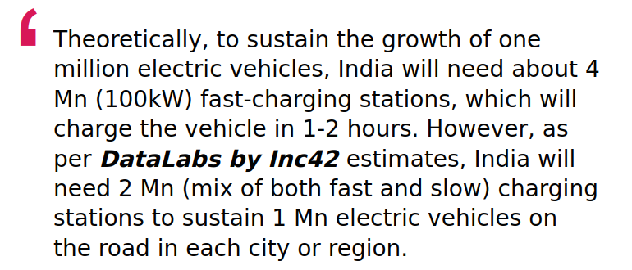
Introduction
The Electric Vehicle (EV) industry in India has seen tremendous growth in recent times due to favourable government regulations and/or incentives and growth in demand among middle-aged urban consumers
Across the globe, there has been an increased focus on shifting to electric mobility. The US and some Nordic countries (Norway, Sweden and Finland) have seen an exponential increase in the number of EVs owned per unit population
In recent years, EVs have become a hot topic for discussion in India as well - for politicians, businessmen and tech giants alike
Several points have been made in favour of EVs, the most common one being that they are environment-friendly (which in hindsight may not be very accurate)
Source: The Math Behind India’s EV Charging Infrastructure (Inc 42)
Notes:
The US and some Nordic countries (Norway, Sweden and Finland) have seen an exponential increase in the number of EVs owned per unit population
In recent years, EVs have become a hot topic for discussion in India as well - for politicians, businessmen and tech giants alike

Slide 3
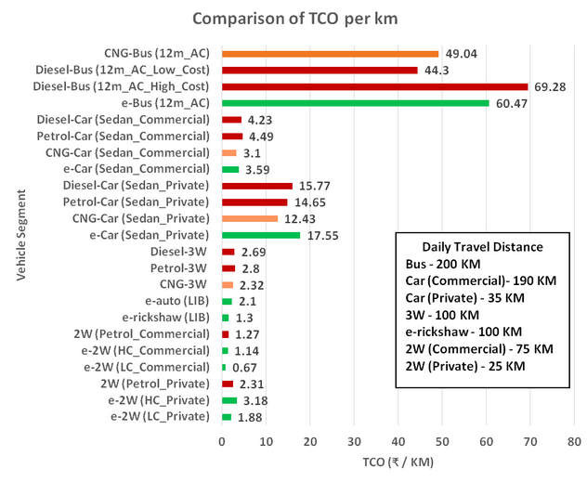
Introduction
Why EVs?
Economical in the long run (low TCO)
No emissions
Quiet operation (no sound pollution)
Smooth running
Good resale value
The challenges
Lack of infrastructure
High purchase costs
Source: World Resources Institute (WRI) India
Notes:
1kwh of lithium ion battery cost is Rs. 25k/-. TCO is total cost of ownership.

Slide 4
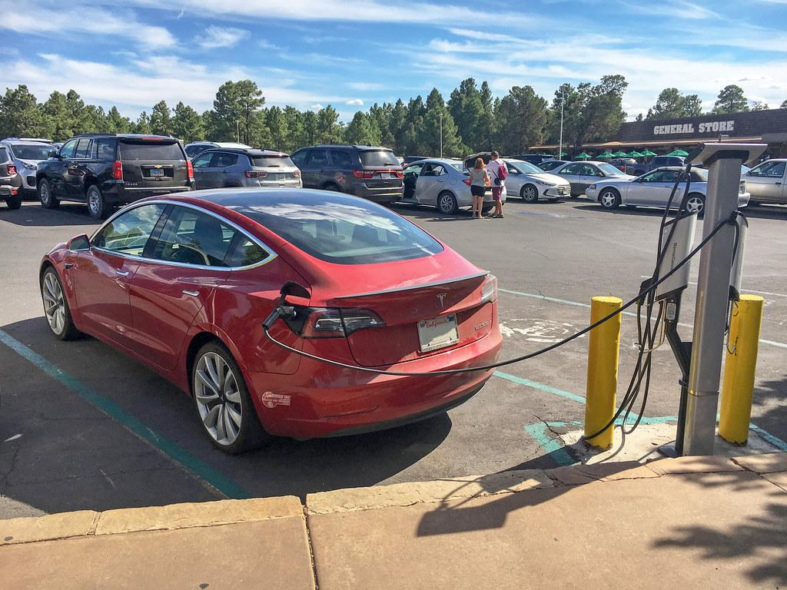
Motivation
There has been a clear rise in demand for electric vehicles in the past few years. This has led to an increased impetus on setting up infrastructure (which includes charging stations, production and maintenance units) that can cater to this increased demand of EVs.
The goal of this project is to explore the various ways in which charging stations can be placed and operated in a given region so as to reduce the number of stations and the total costs involved in constructing and/or operating them. An optimal charging station network will minimize capital cost and improve driver experience.
Source: https://cronkitenews.azpbs.org/2019/09/10/grand-canyon-ev-chargers/

Slide 5
Problem statement
The city is divided into several demand hotspots, where the demand of a particular locality is assumed to be concentrated.
Given a set of possible locations for constructing charging stations, we need to choose a subset which will lead to minimum total customer travel from demand hotspots to charging stations.

Slide 6
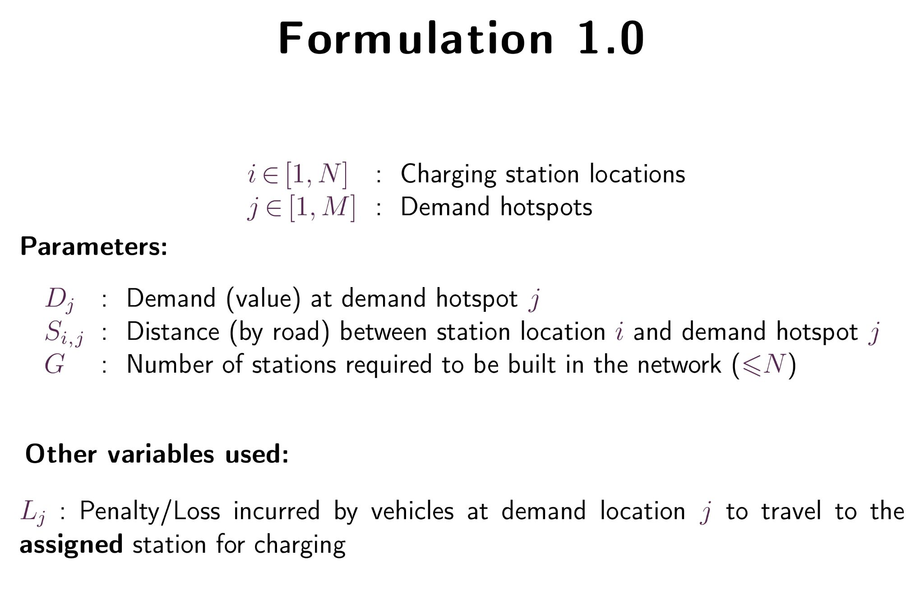

Slide 7
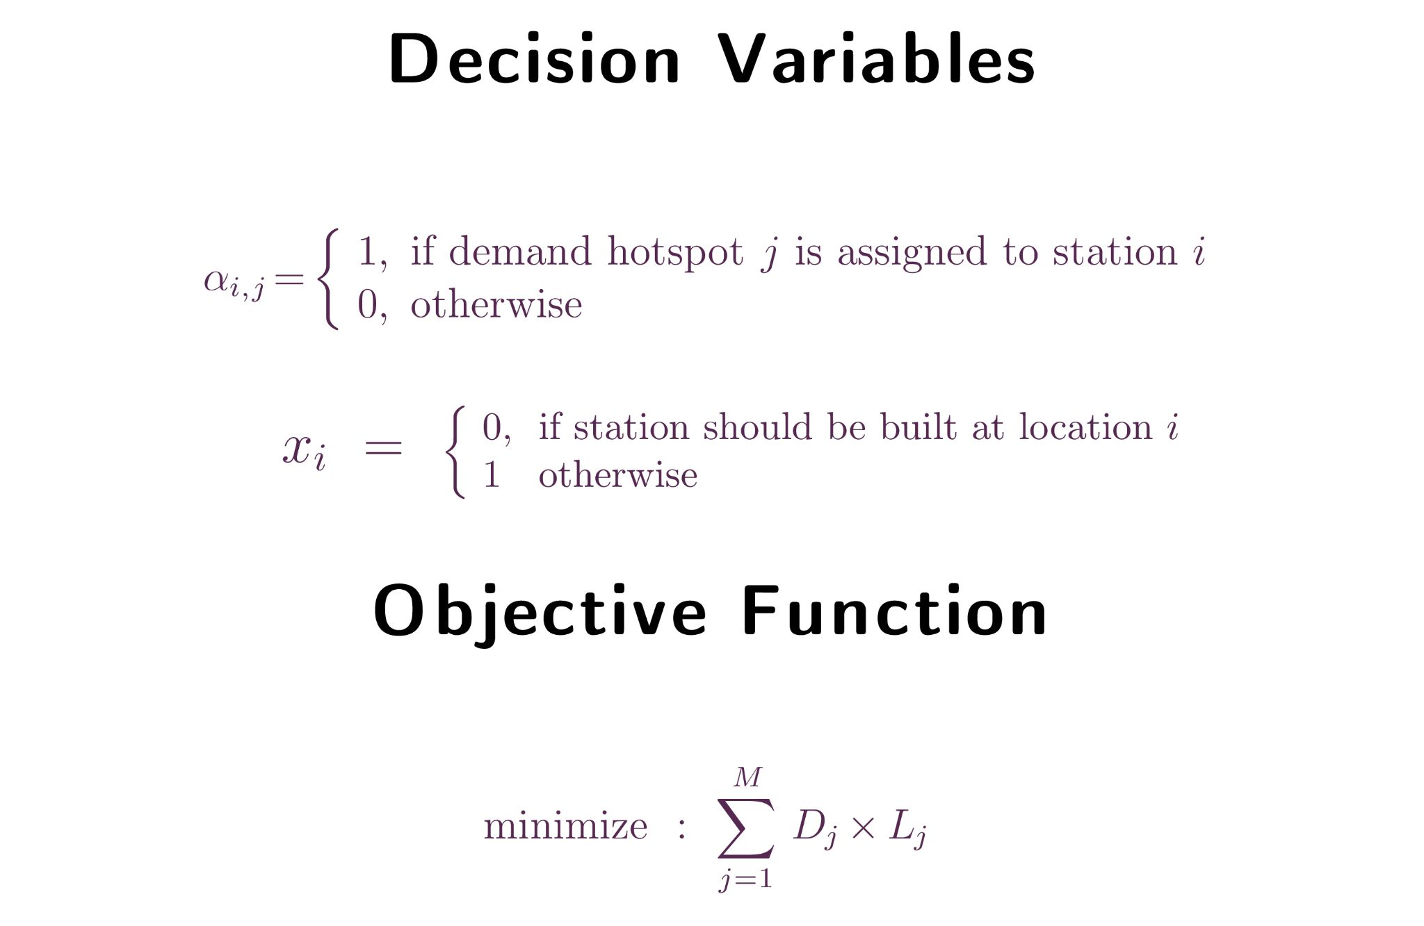

Slide 8
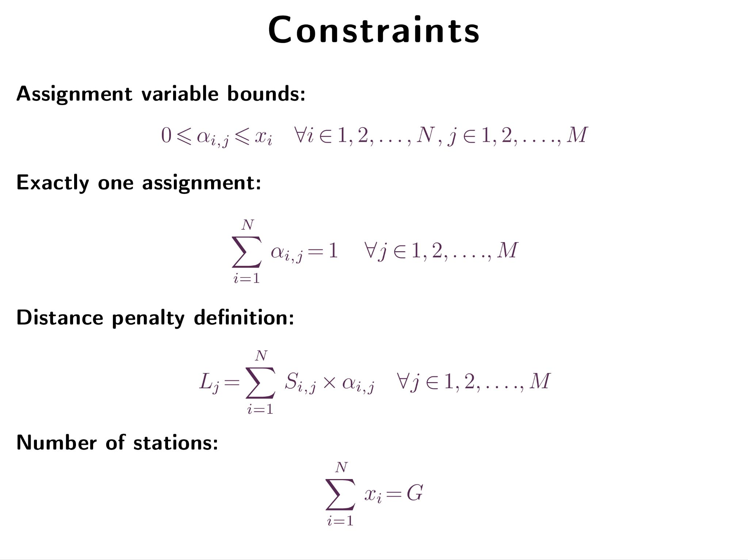

Slide 9
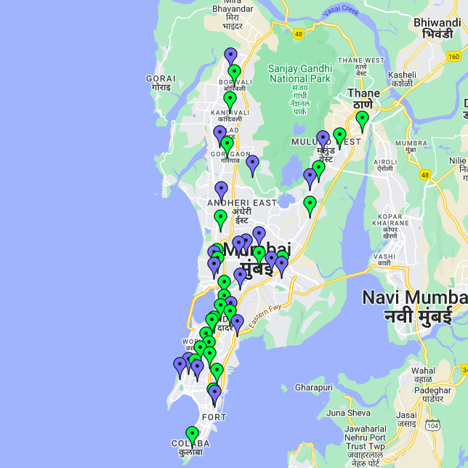
Case Study: Mumbai
🟢 Possible charging station locations Selected close to existing petrol pumps
🔵 Demand hotspots (one for each locality) Situated close to the railway station

Slide 10
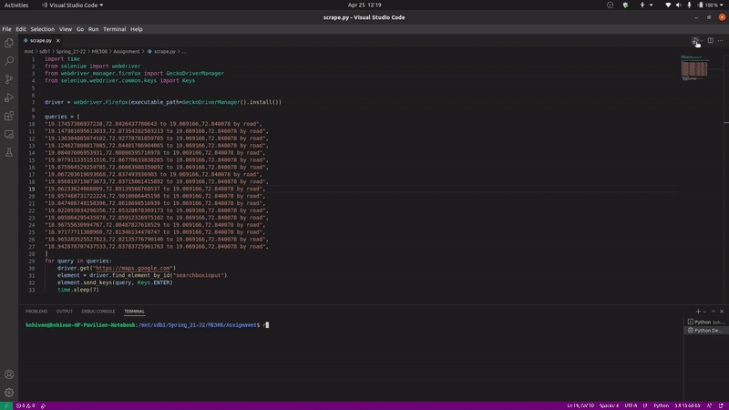
Acquiring Data: Distances
Notes:
Distance Marix API
Browser automation using Selenium

Slide 11
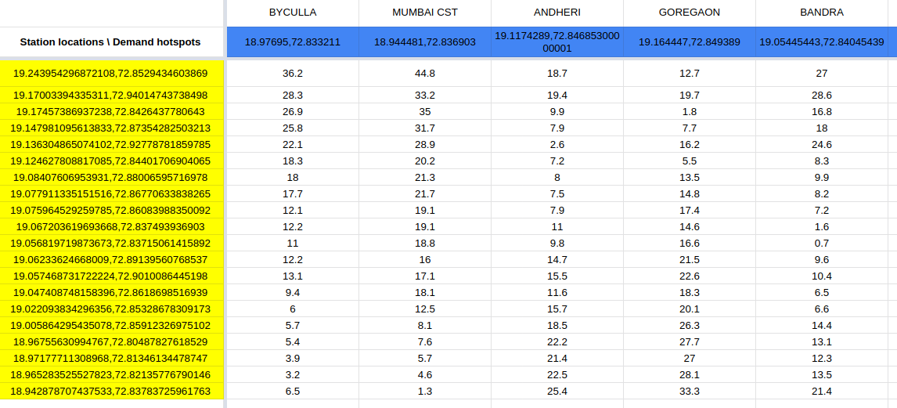
Distance Matrix
Notes:
Distance Marix API
Selenium

Slide 12
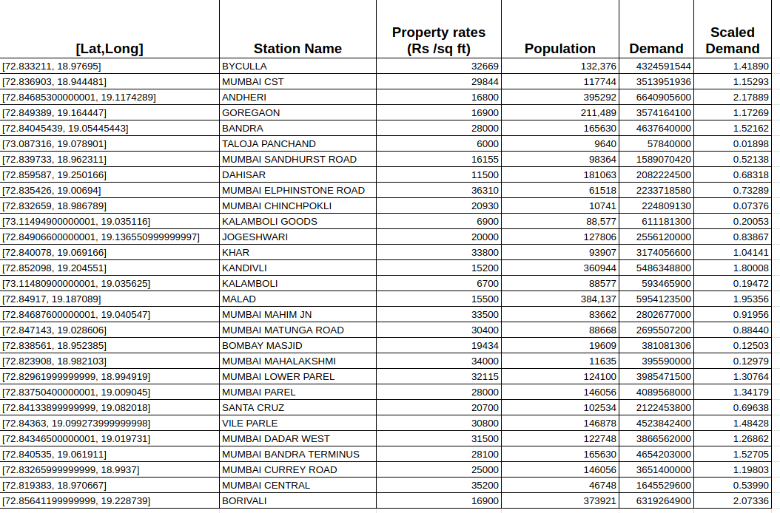
Acquiring Data: Demands
Scaled down with respect to mean as the reference

Slide 13
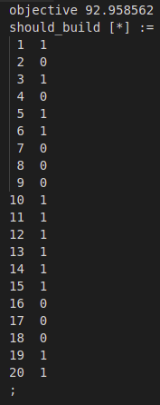
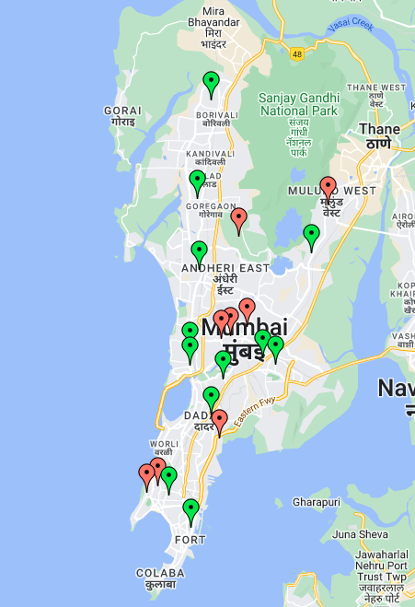
Results (1)
Charging station should be built at 3 but not at 4
🔴 Rejected locations
🟢 Accepted locations

Slide 14
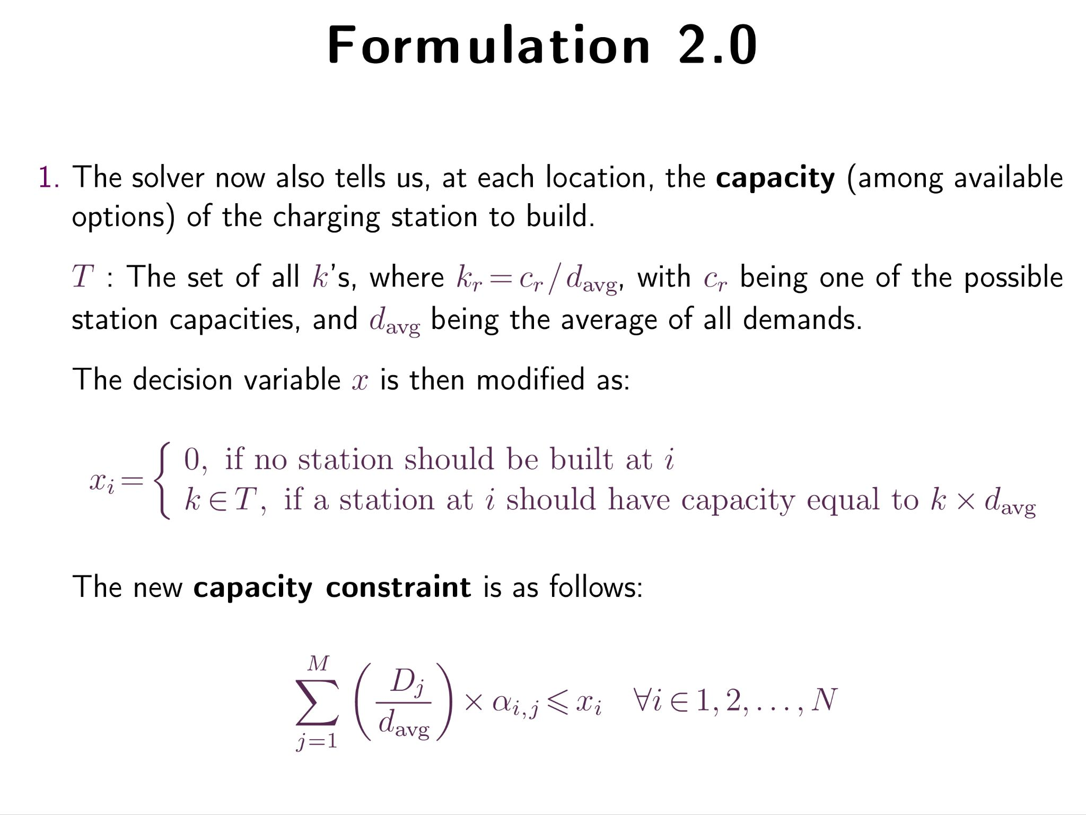

Slide 15
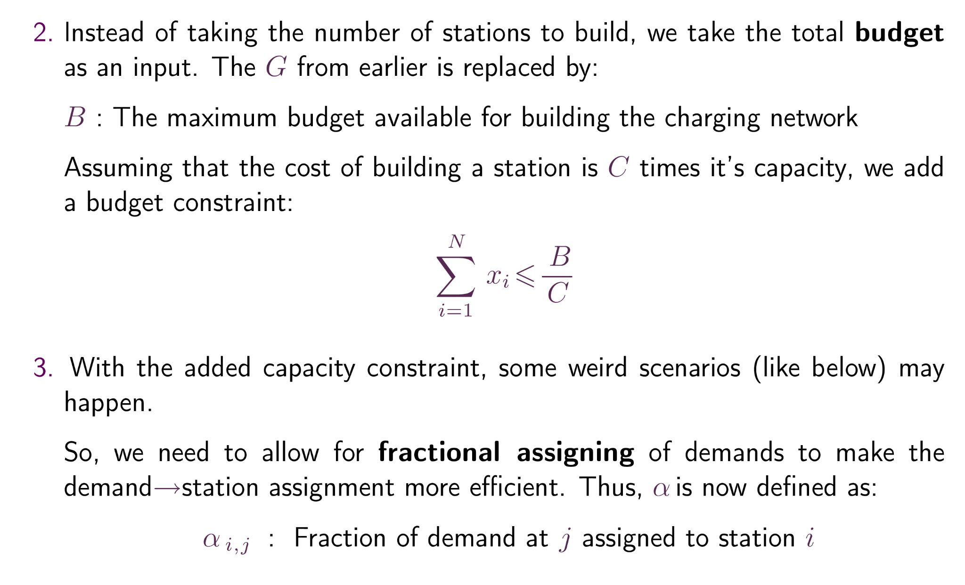

Slide 16
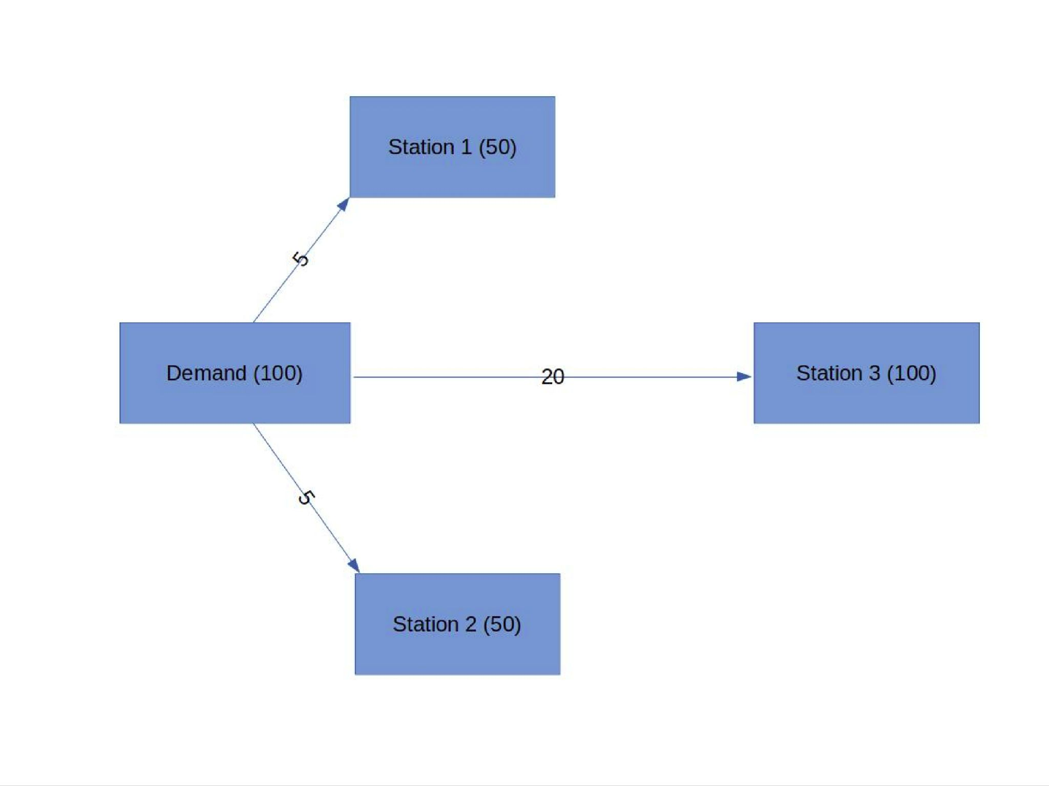
The case of fractional demand
Notes:
This will not happen with our formulation, since the solver itself selects the capacities. However, this could happen if the set of possible capacities is different for each location, which is very much possible in real world situations. For example, if the locations 1 and 2 can hold only stations with capacity upto 50, then it is better to split the demand rather than build a 100-capacity station much farther away.

Slide 17
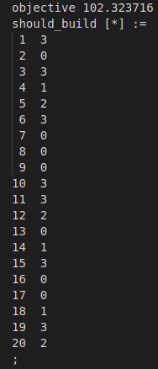
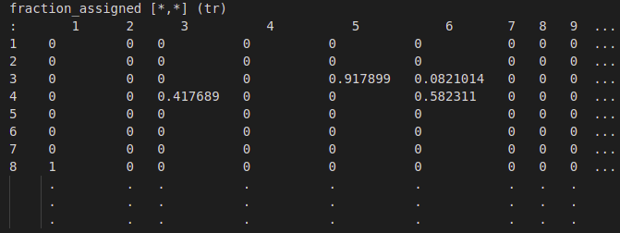
Results (2)
Total loss has increased, since all cars may not go to closest station now (because of capacity constraints)
Capacity at location 6 should be 1.5x the capacity at station 5
Fraction of demand (4) assigned to charging station (6)

Slide 18

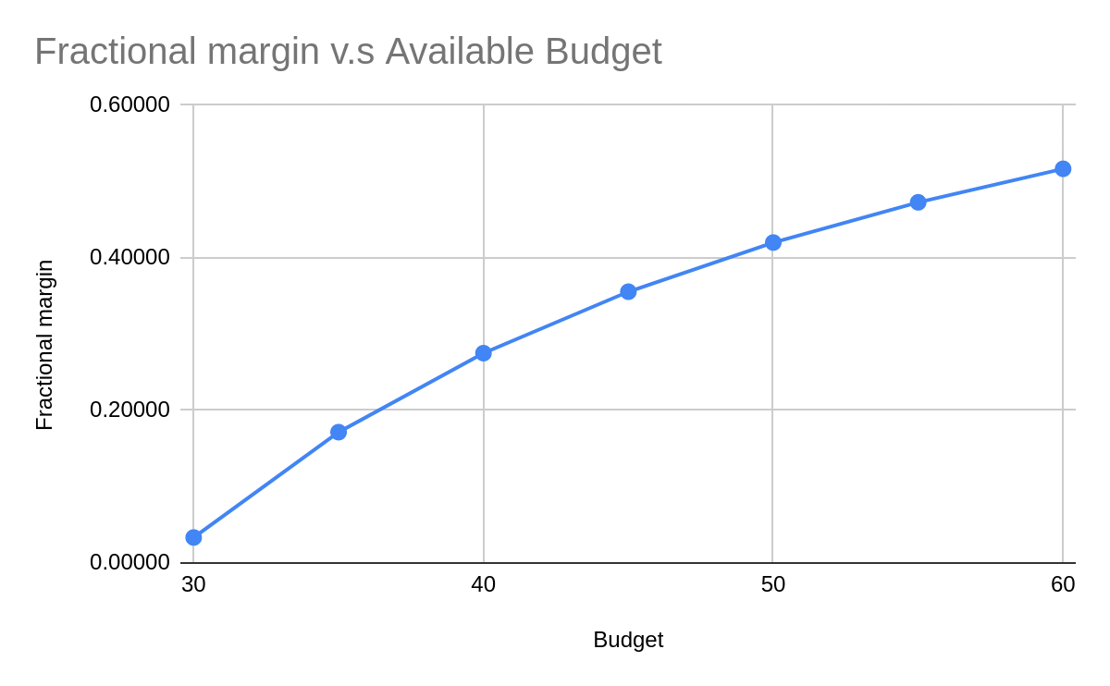
Variation of fractional margin with budget
Notes:
Fractional capacity margin

Slide 19
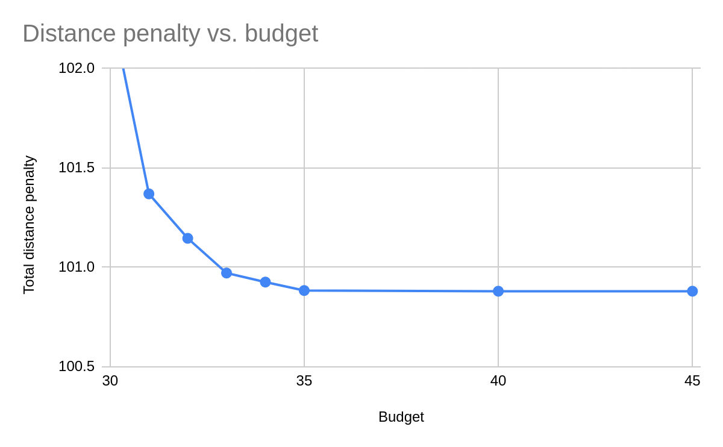
Variation of distance penalty with budget

Slide 20
Challenges faced
Converting the earlier double minimization problem into a simple linear objective function using intermediate variable: L_{j}
Pinpointing demand hotspots and calculating corresponding demands
Finding distances between hotspots and selected charging stations and generating corresponding distance matrix

Slide 21
Conclusions
Given a budget, demands and distances between demands and station locations, our model can tell us if it is possible to satisfy all demands within the budget.
If it is possible to do so, it will choose that optimal subset of charging station locations which will lead to minimum customer travel time.

Slide 22
Further work
Account for government constraints regarding minimum distance between two stations in a city (~3 kms).
Handle different types of chargers – for example, AC and DC.
Take into account operational cost of charging station, over and above the building cost. This will depend on the demand assigned to a station and types of chargers used.

Slide 23
References
Charging Infrastructure for Electric Vehicles: Revised Guidelines, Ministry of Power, GoI (Oct ‘19)
Handbook of Electric Vehicle Charging Infrastructure Implementation, NITI Aayog
Cavadas, Joana, Gonçalo Correia, and João Gouveia. "Electric vehicles charging network planning." Computer-based modelling and optimization in transportation. Springer, Cham, 2014. 85-100.
Istiqomah, Silvi, and Wahyudi Sutopo. "Optimization of network design for charging station placement: A case study." Proceedings of the International Conference on Industrial Engineering and Operations Management. 2020.
Wenzao Li, Lingling Yang, Zhan Wen, Jiali Chen, Xi Wu, "On the Optimization Strategy of EV Charging Station Localization and Charging Piles Density", Wireless Communications and Mobile Computing, vol. 2021, Article ID 6675841, 13 pages, 2021.

Slide 24
Thank you!
Link to Github Repository

